Slide 1
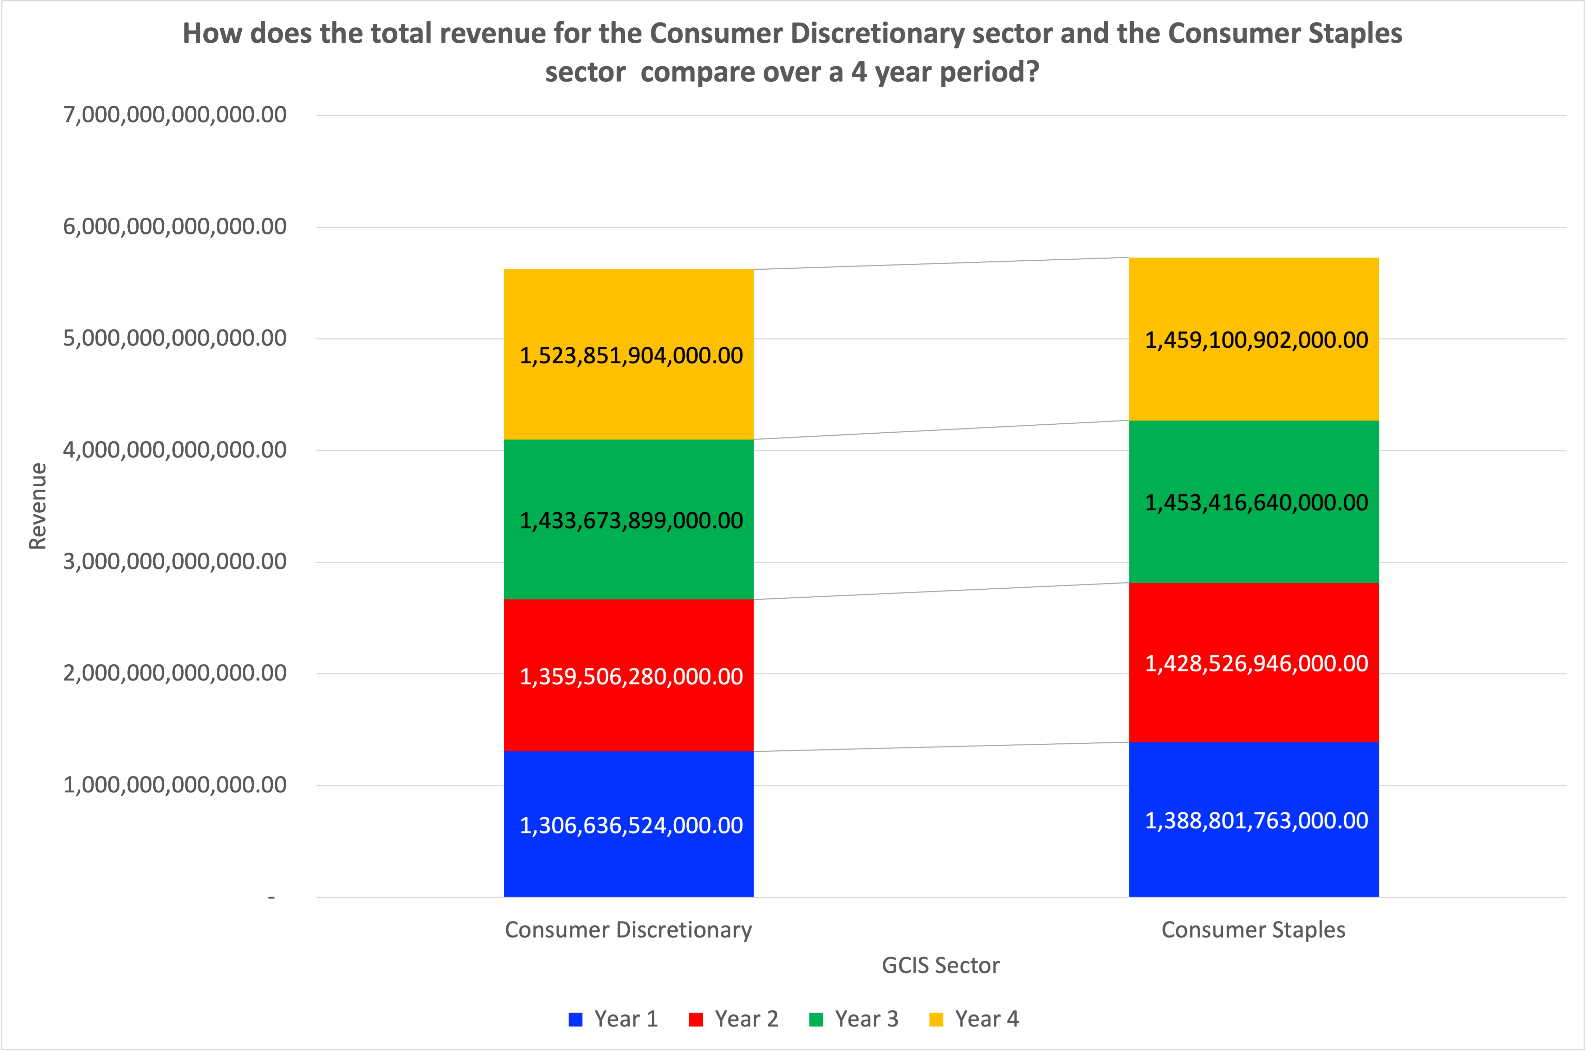
How does the total revenue for the Consumer Discretionary sector and the Consumer Staples sector compare over a 4 year period?
The total revenues for the Consumer Discretionary ($5,623,668,,607,000) and Consumer Staples ($5,729,846,251,000) were the highest of all the GICS sectors, over the four-year period. During the first three years, Consumer Staples had a higher average revenue ($1,423,581,783,000), than the Consumer Discretionary sector ($1,366,605,567,667). In the fourth year Consumer Discretionary had the highest revenue ($1,523,851,904,000). Consumer Staples had the highest revenue and a low standard deviation, meaning more stability in the market. The range of the total revenue over the four-year period, for the Consumer Discretionary sector ($217,215,380,000) is three times higher than the range for the Consumer Staples sector ($$70,299,139,000). Based on the low range, the Consumer Staples sector has less variability amongst it’s companies, unlike the Consumer Discretionary sector.

Slide 2
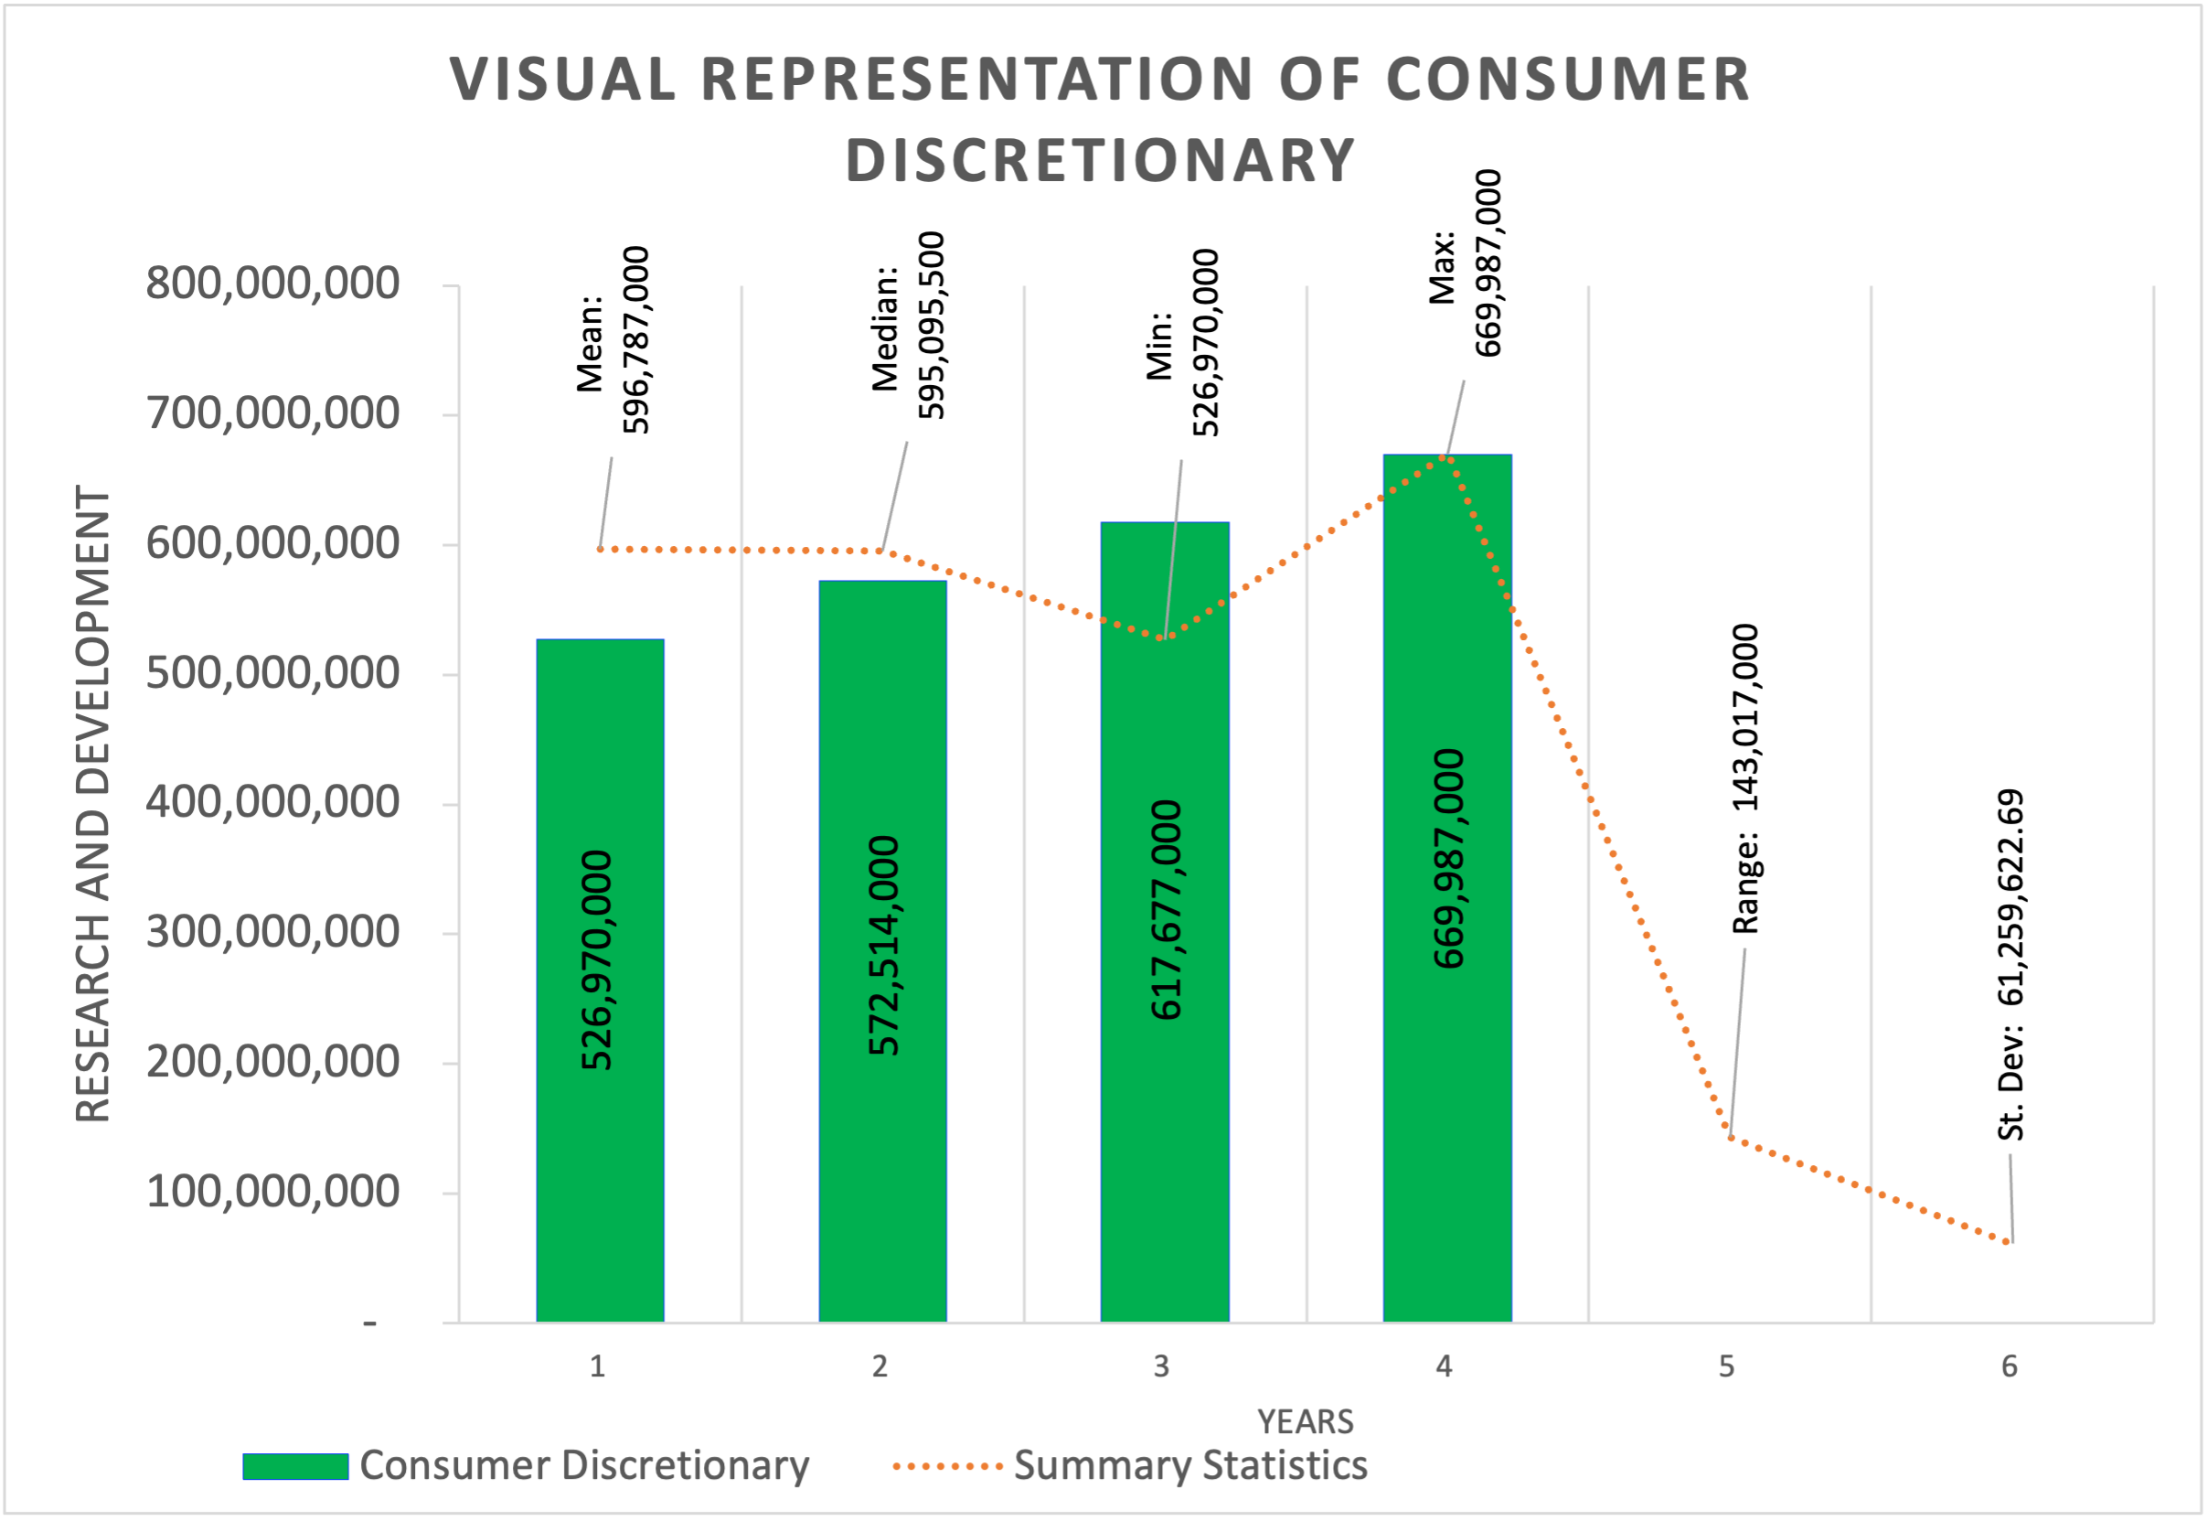
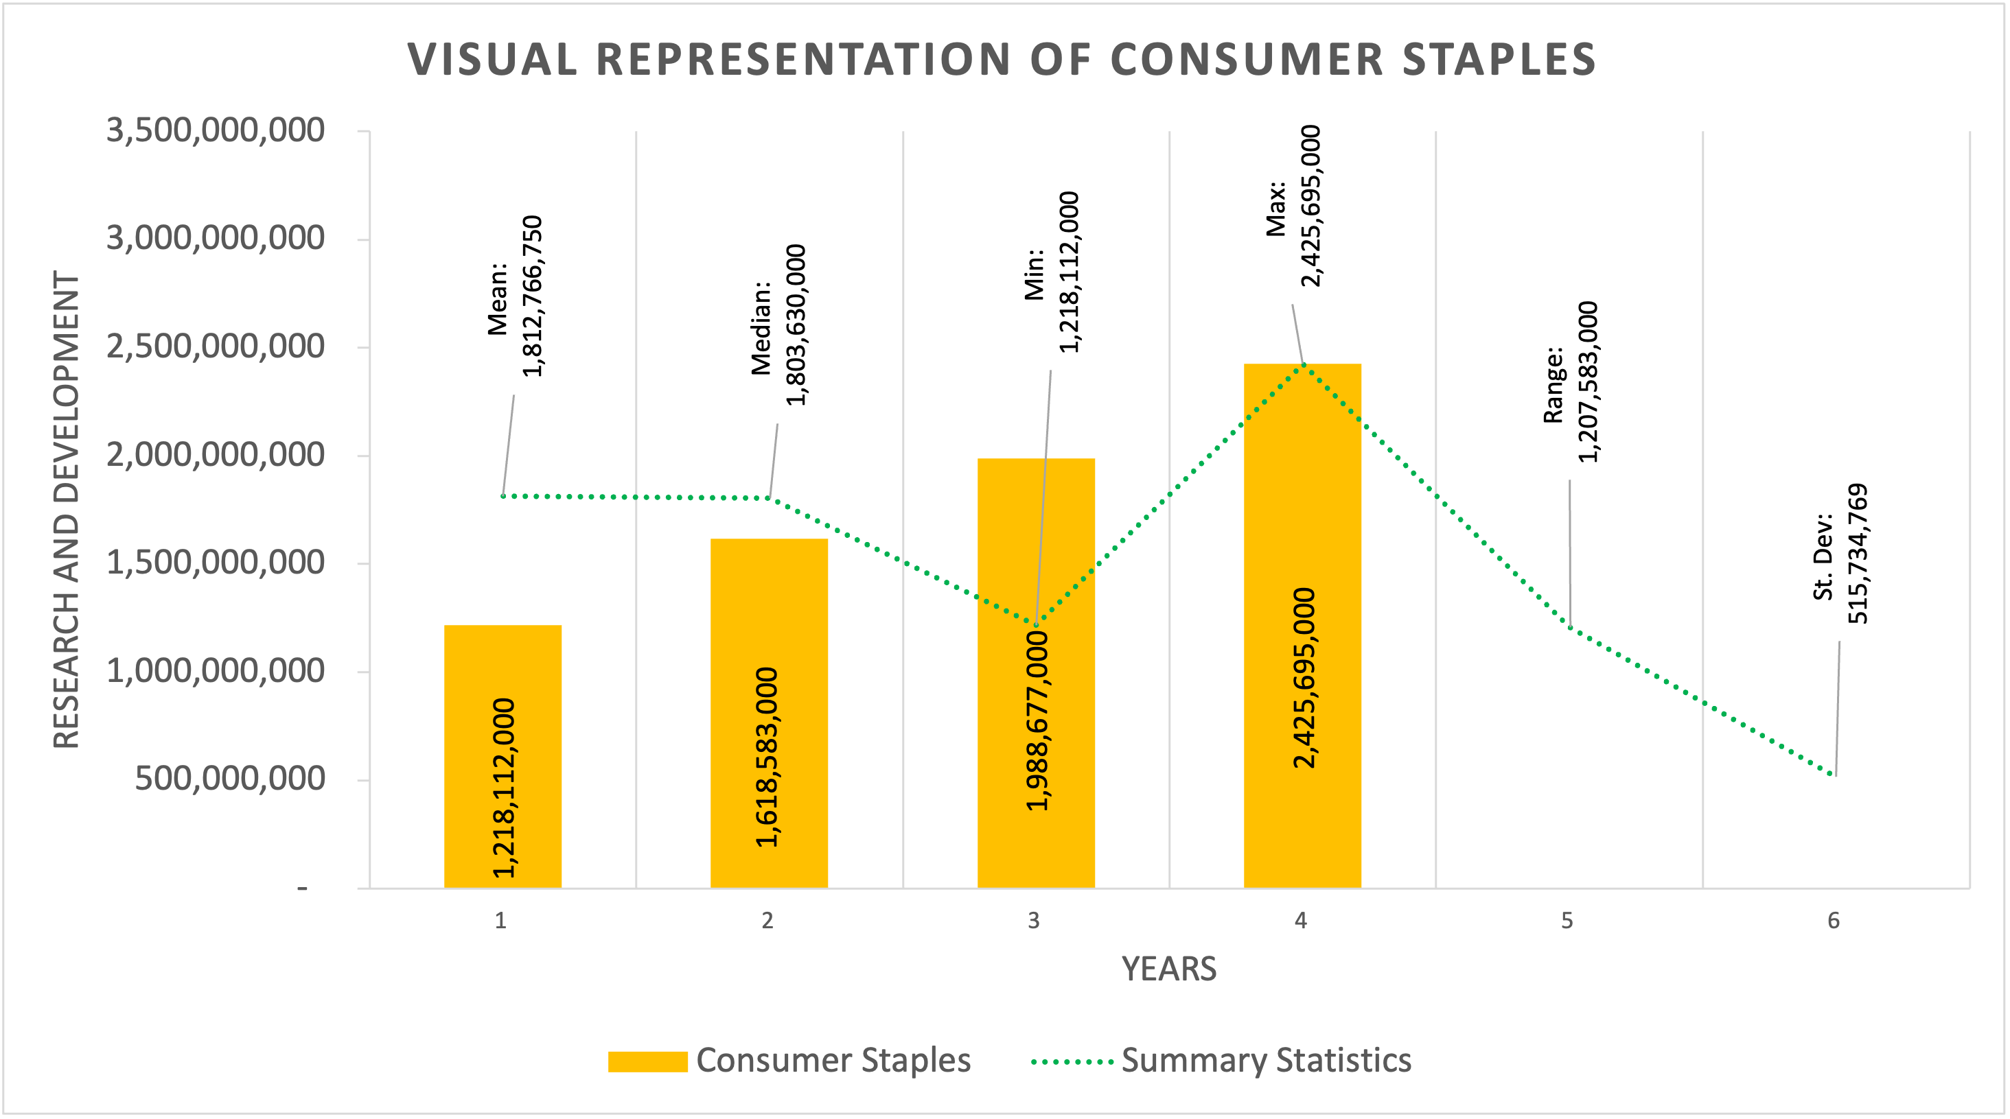
How does the Consumer Discretionary R&D expenditures compare to the Consumer Staples R&D expenditures?
The Consumer Staples sector had the largest amount of Research and Development expenditures ($7,251,067,000), over the four-year period. The Consumer Discretionary R&D expenditures steadily grew over the four-year period and had a lower standard deviation (61,259,623), than that of the Consumer Staples sector ($515,734,769). This means that the Consumer Discretionary sector was more stable with their R&D expenditures; which could be attributed to this sector providing the top revenue of all sectors in the fourth year. The range for the Consumer Discretionary sector ($143,017,000) was much lower than that of the Consumer Staples sector ($1,207,583,000). Based on the lower range for the Consumer Discretionary sector has less variability.

